Slide 1
Prediction of Cardiovascular Disease
By: Yesha Desai

Slide 2
Roadmap
Problem Definition and Significance
Prior literature summary
Data Source and Preparation
Visualizations
Models
Recommendation
Conclusion

Slide 3
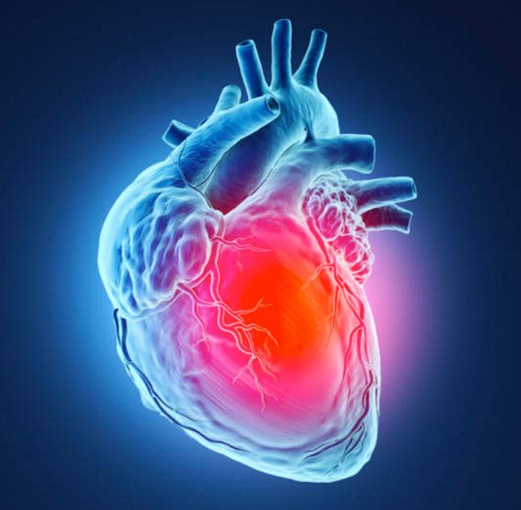
Problem Significance
Detecting and managing risk factors early is crucial to mitigate the impact of cardiovascular diseases, which rank among the leading causes of death worldwide. Accurately predicting the probability of cardiovascular disease using diverse factors can take quick actions and prevention measures.
Heart disease persists as the leading global cause of death, with approximately 17.9 million deaths associated to cardiovascular diseases in 2019, representing 32% of all global death. Out of which, 85% resulted from heart attacks and strokes.
The target clients for this project are Healthcare Providers, Public Health Organizations and Medical Researchers

Slide 4
Prior Literature Summary
Topic | Methodology | Insights
Efficient Heart Disease Prediction System | The dataset is preprocessed using KEEL tool (Knowledge Extraction based on Evolutionary Learning) and hill climbing algorithm. Then, the rules are classified into different sets, evaluating the system's performance through 10-fold cross-validation. | The outcome showed that the Efficient Heart Disease Prediction System achieved a higher accuracy rate (86.7%) compared to other well-known classifiers such as SVM, C4.5, NN, PART, MLP, RBF, and TSEAFS, as demonstrated by the evaluation on the heart disease dataset.
Heart Disease Prediction using Logistic Regression | This paper has used two methods: binary logistic regression and robust methods with BLR to predict heart disease. Robust methods: least quartile difference and median absolute deviation handled outliers and multicollinearity. | The comparison of percentage accuracy among all models was done and it showed that the binary logistic model with the applied MAD method achieved the highest accuracy at 86.6%. Hence, this model was selected as their best among the others.

Slide 5
Data Source and Preparation
Data Source:
The dataset is related to medical information collected during a cardiovascular examination. The data consists of various features:
Data Processing:
Dropped the ‘id’ column as it was considered repeated in the dataset.
> Age
> Height
> Weight
> Gender
> Systolic blood pressure
> Diastolic blood pressure
> Cholesterol
> Glucose
> Smoking
> Alcohol intake
> Physical activity
> Presence or absence of cardiovascular disease
Converted Age feature from days to years by dividing the ‘age’ column by 365.
Checked and removed duplicate values in the data. This ensures the dataset contains unique entries, avoiding redundancy in the analysis.
The dataset is complete, with no instances of missing data, ensuring the reliability of the analysis and model training.

Slide 6
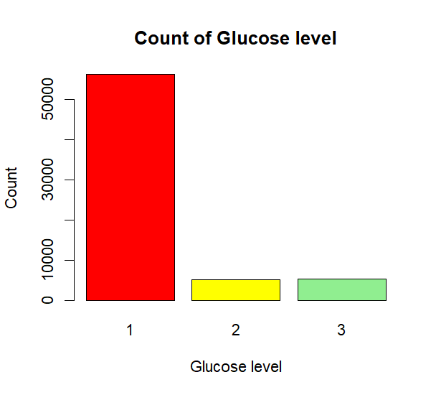
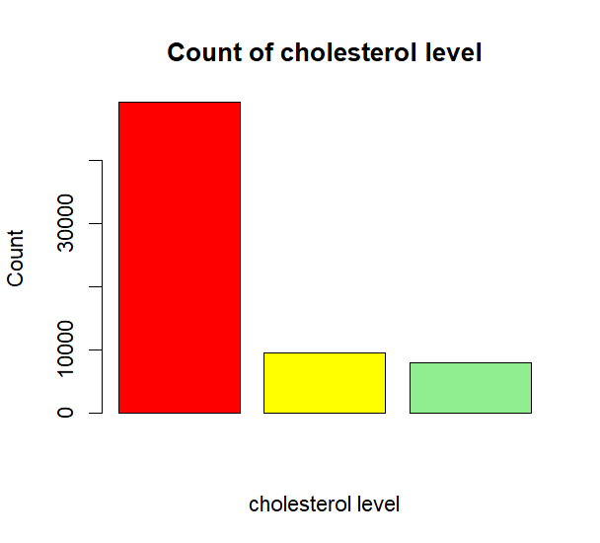
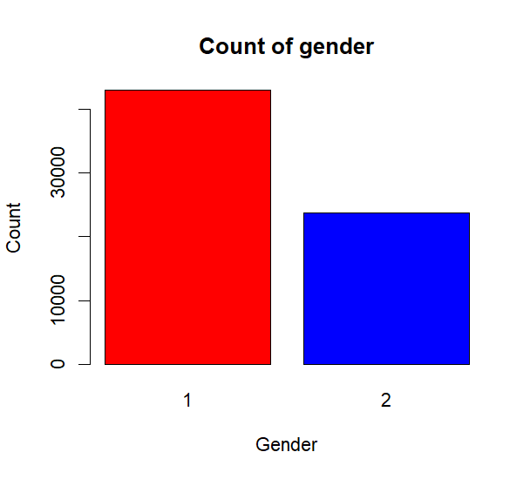
Visualizations: Distribution of Features
.

Slide 7
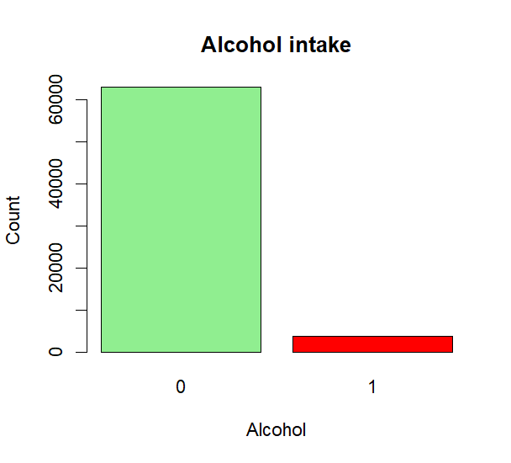
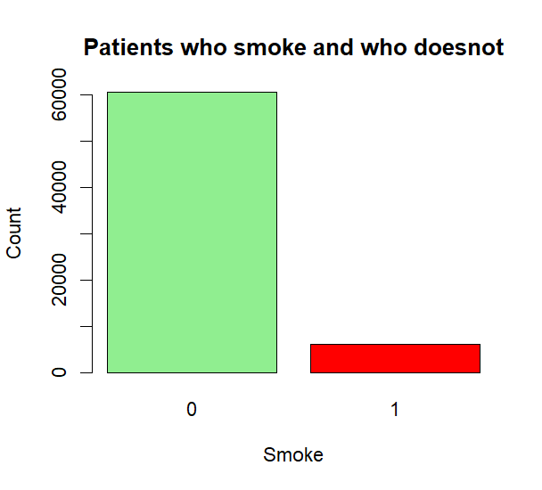
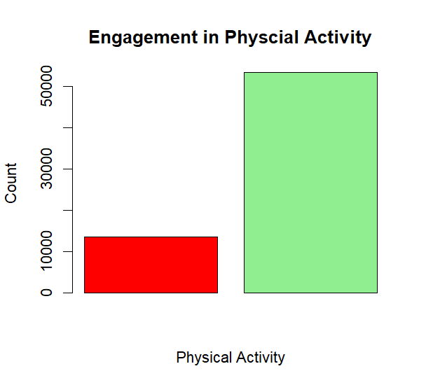
Visualizations: Distribution of Features
.

Slide 8
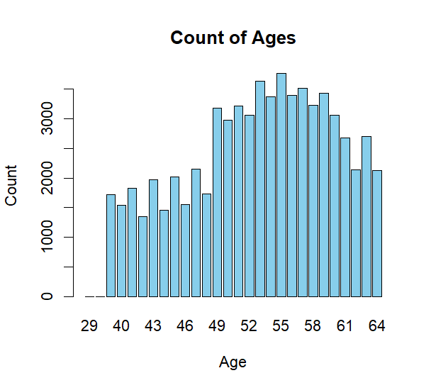
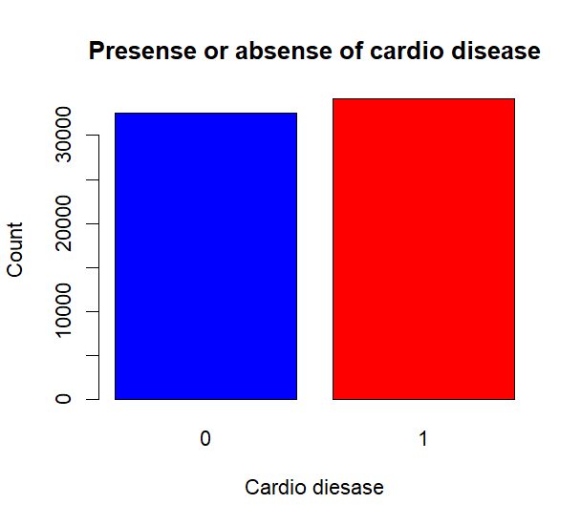
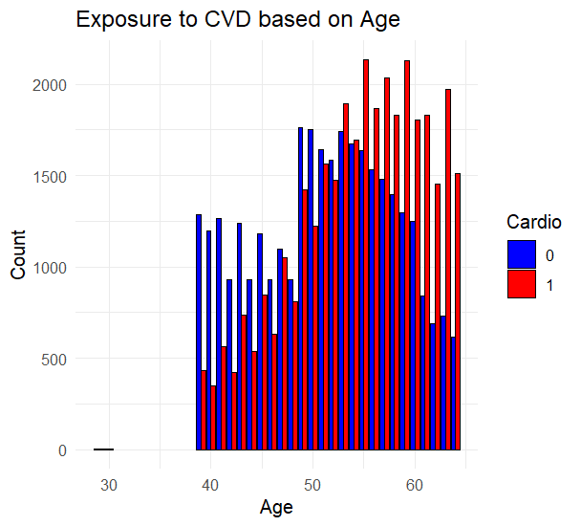
Visualizations

Slide 9
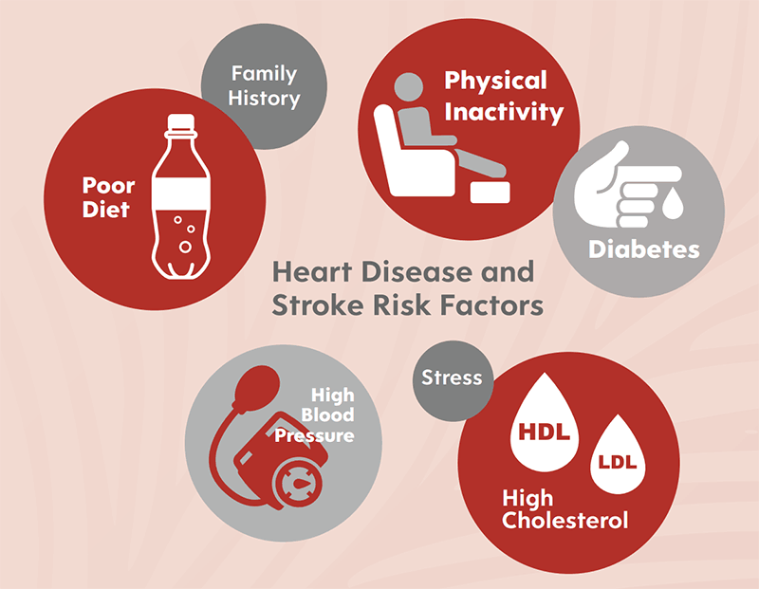
Models
Logistic Regression Model
Probit Regression Model
Complementary Log Log Regression Models

Slide 10
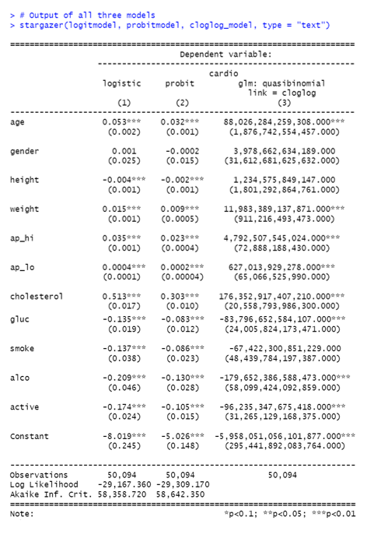
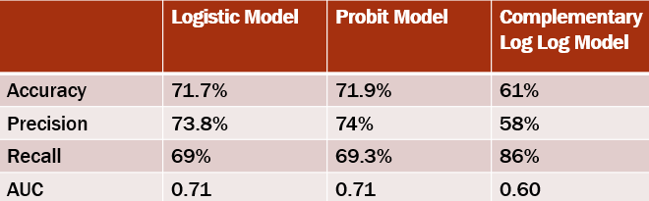
Models Result
Each model provides estimates of the effects of predictors such as age, gender, height, weight, blood pressure, cholesterol level, and lifestyle factors on the likelihood of having cardiovascular disease.

Slide 11
Recommendation
Factors such as weight, blood pressure (both systolic and diastolic), cholesterol level, and glucose level are significant predictors of cardiovascular disease.
Individuals should strive to maintain a healthy weight, monitor their blood pressure regularly, and keep their cholesterol and glucose levels within recommended ranges.
Being active is negatively associated with the likelihood of cardiovascular disease. Engaging in regular physical activity can help improve overall cardiovascular health and reduce the risk of developing heart-related conditions.

Slide 12
Conclusion
Based on the performance metrics and interpretations, the probit model appears to be the best model among the three, as it achieves the highest accuracy and precision while maintaining balanced recall.

Slide 13
Thankyou!

Slide 14
References
https://www.kaggle.com/datasets/sulianova/cardiovascular-disease-dataset/data
https://penerbit.uthm.edu.my/periodicals/index.php/ekst/article/view/2163
https://www.sciencedirect.com/science/article/pii/S187705091630638X

